Slide 1
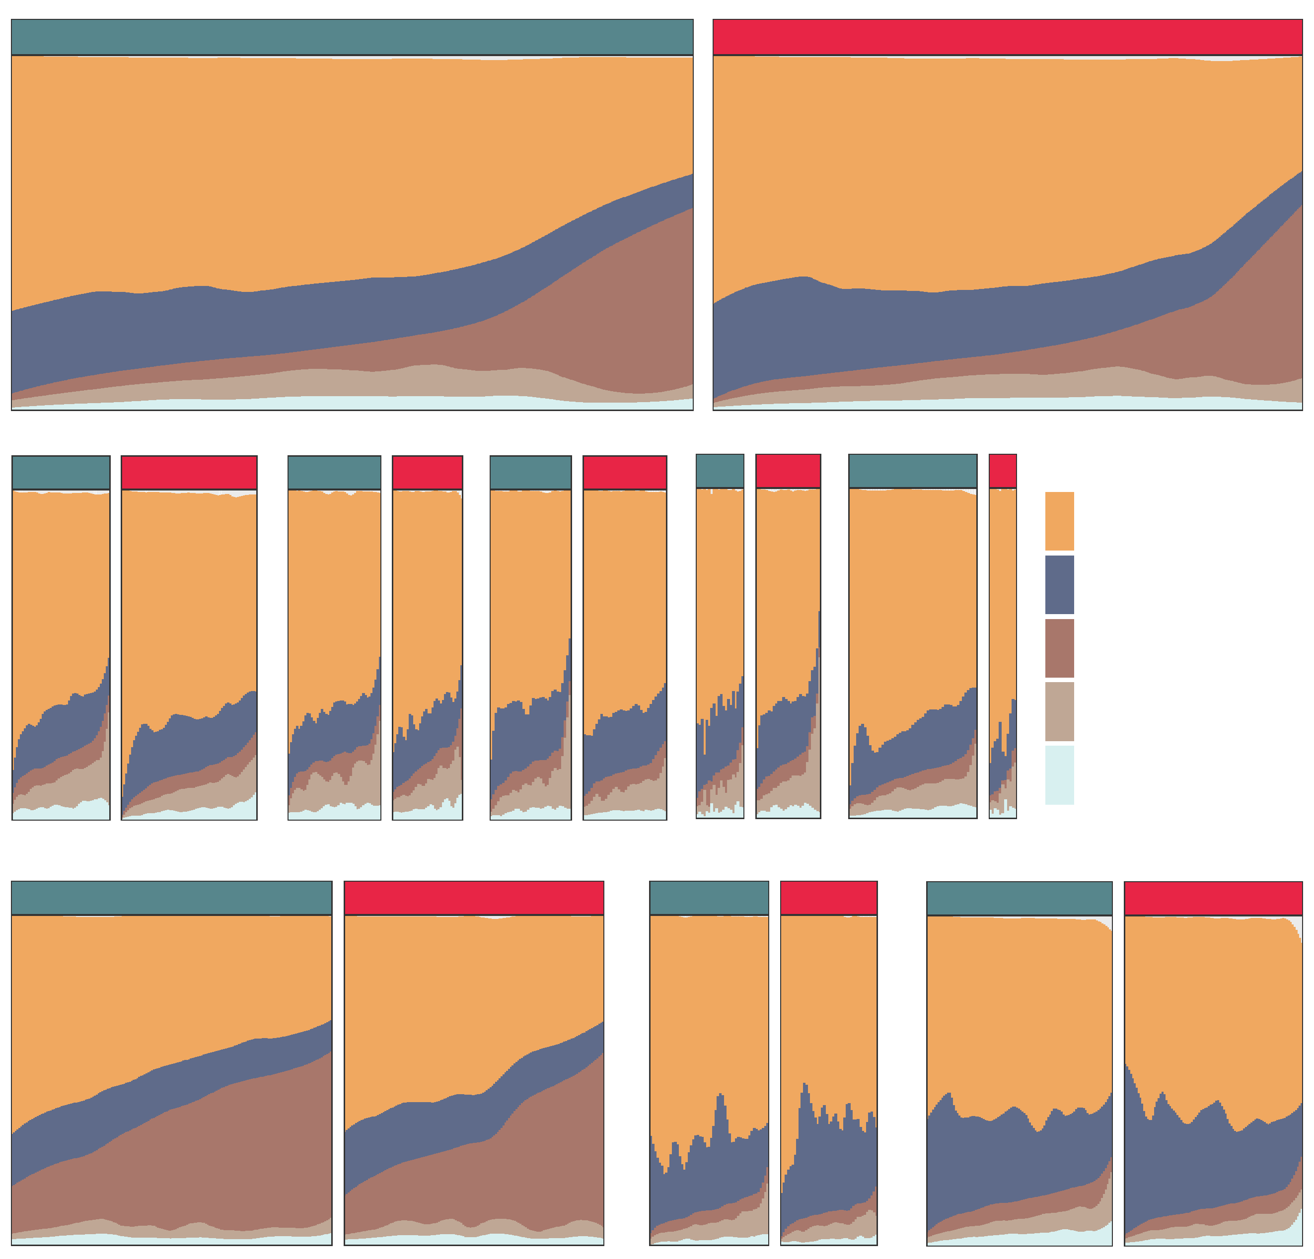
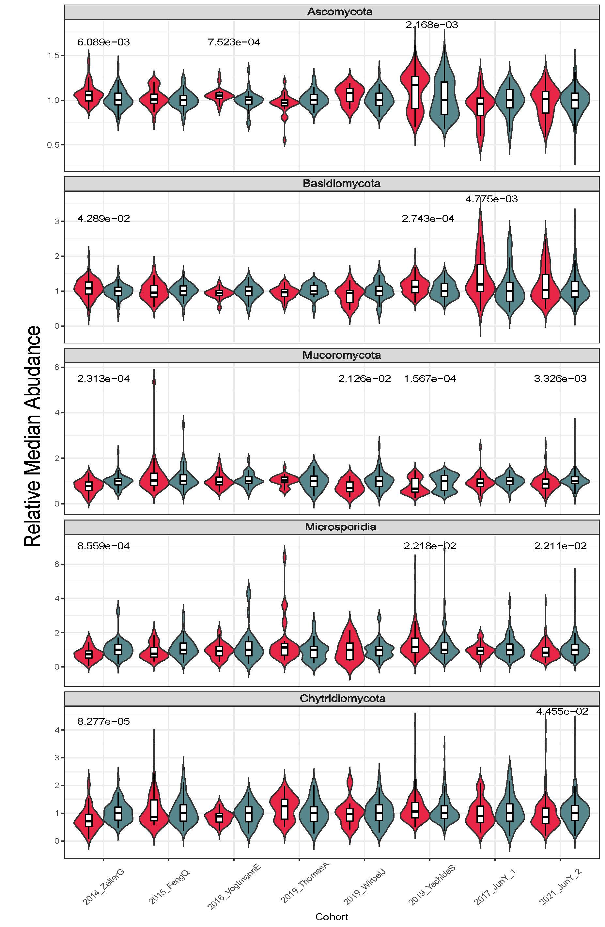

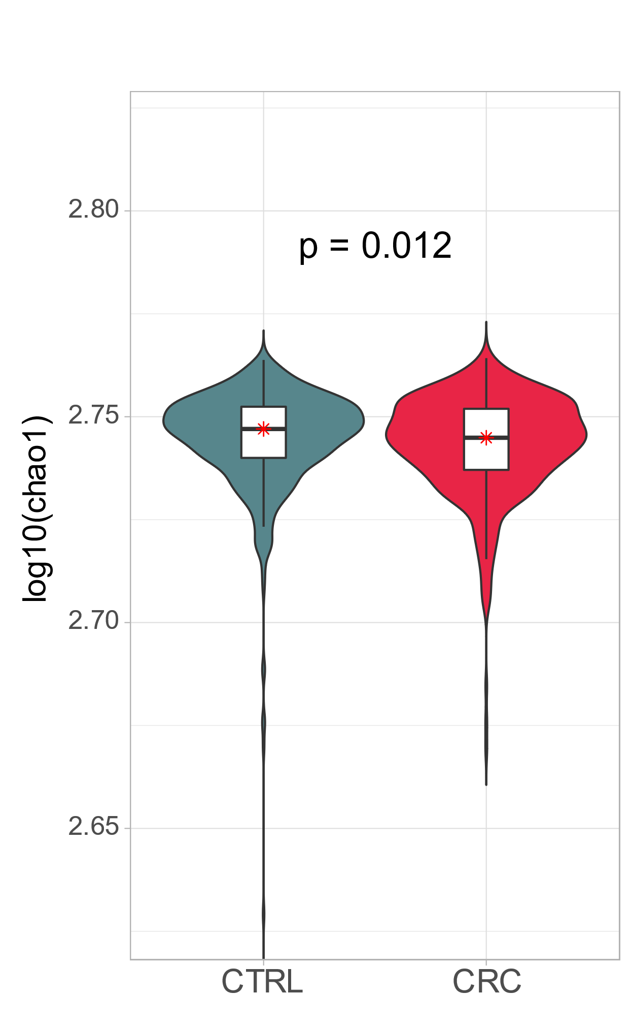
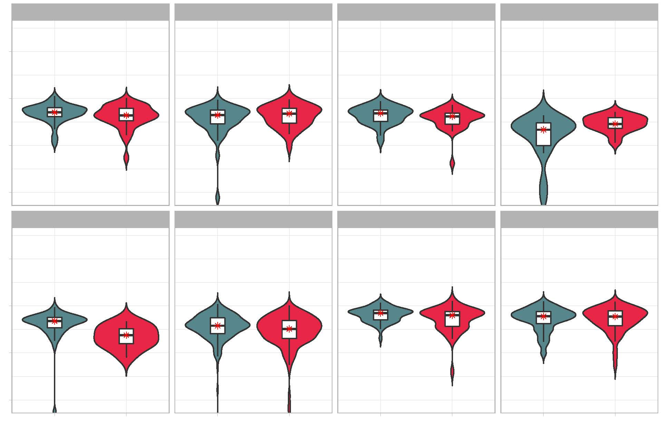
a
c
Control
CRC
b
2014_ZellerG (EU)
2015_FengQ (OC)
2016_VogtmannE (NA)
2019_ThomasAM (EU)
2019_WirbelJ (EU)
Control
CRC
Control
CRC
Control
CRC
Control
CRC
Control
CRC
CORE PHYLUM
Ascomycota
Basidiomycota
Mucoromycota
Microsporidia
Chytridiomycota
Control
2019_YachidaS (AS)
CRC
2017_YuJ (AS)
2021_YuJ (AS)
Control
CRC
Control
CRC
2014_ZellerG (EU)
2015_FengQ (OC)
2016_VogtmannE (NA)
2019_ThomasAM (EU)
2019_WirbelJ (EU)
2019_YachidaS (AS)
2017_YuJ (AS)
2021_YuJ (AS)
d
2014_ZellerG (EU)
2015_FengQ (OC)
2016_VogtmannE (NA)
2019_ThomasAM (EU)
2.80
0.014
2.76
2.72
2.68
2019_WirbelJ (EU)
2019_YachidaS (AS)
2017_YuJ (AS)
2021_YuJ (AS)
2.80
0.00038
0.017
2.76
2.72
2.68
CTRL
CRC
CTRL
CRC
CTRL
CRC
CTRL
CRC
S figure 2

